Slide 1

Housing Dataset
Denzel See DAAA2A07 2222840

Slide 2

Objective
To build a model that predicts the housing price in US based on various factors such as city, house area, etc.

Slide 3
Data visualization + cleaning

Slide 4
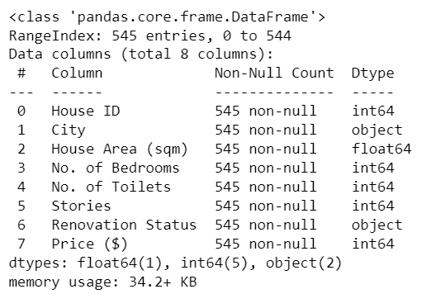
Data Information
I used .info() to print out the information of the dataset

Slide 5
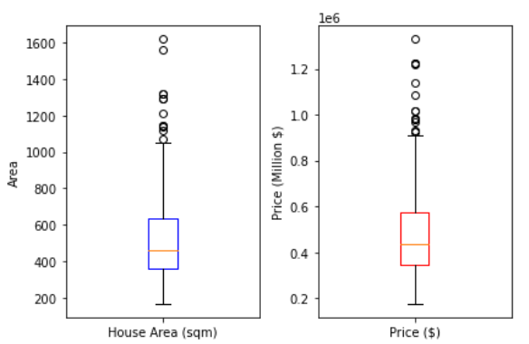
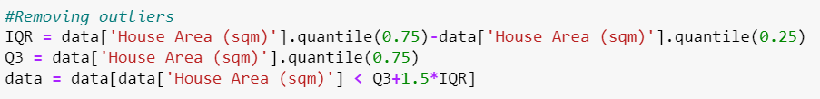
Checking for outliers
I plotted the data into a boxplot to check their mean, median, IQR and outliers.
I then removed the outliers by establishing an upper bound of Q3+1.5*IQR and removing anything below it

Slide 6
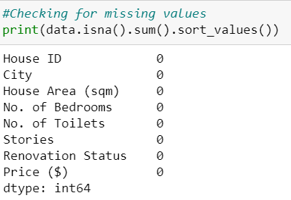
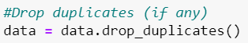
Null values and Duplicates
I then checked for null values and drop any duplicates

Slide 7
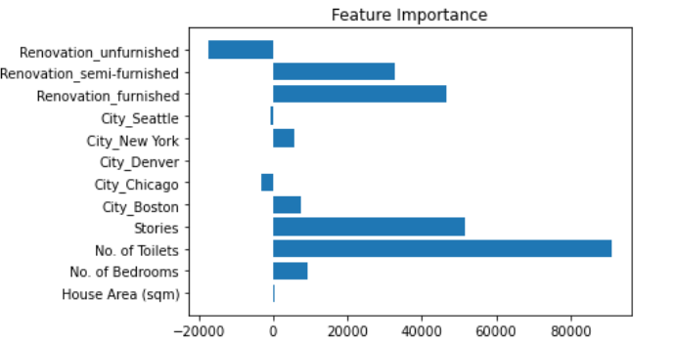
Feature Importance
I used Lasso to create a feature importance graph

Slide 8
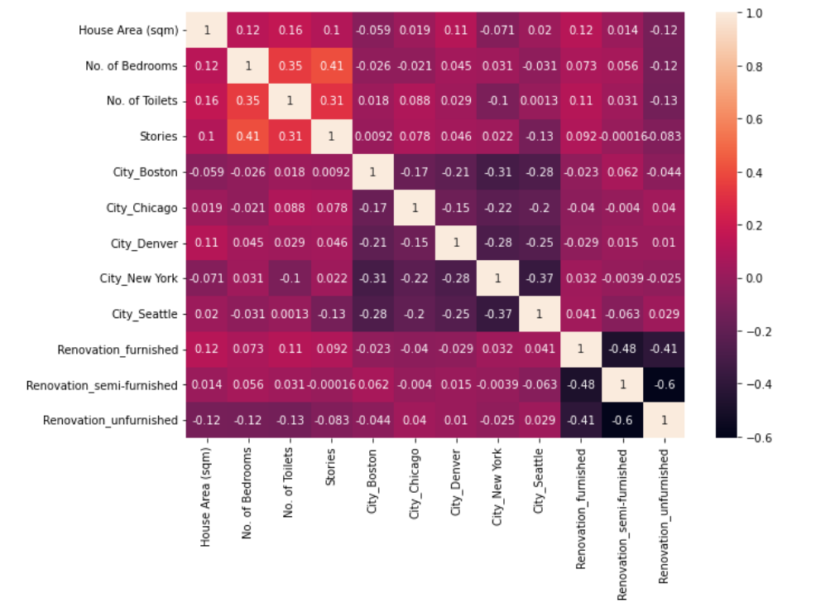
Correlation Heatmap
This is a correlation heatmap that I used to see the correlation between features.
I removed features that have a high correlation with one another such as Renovation_unfurnished to prevent multicollinearity

Slide 9
Feature Importance

Slide 10
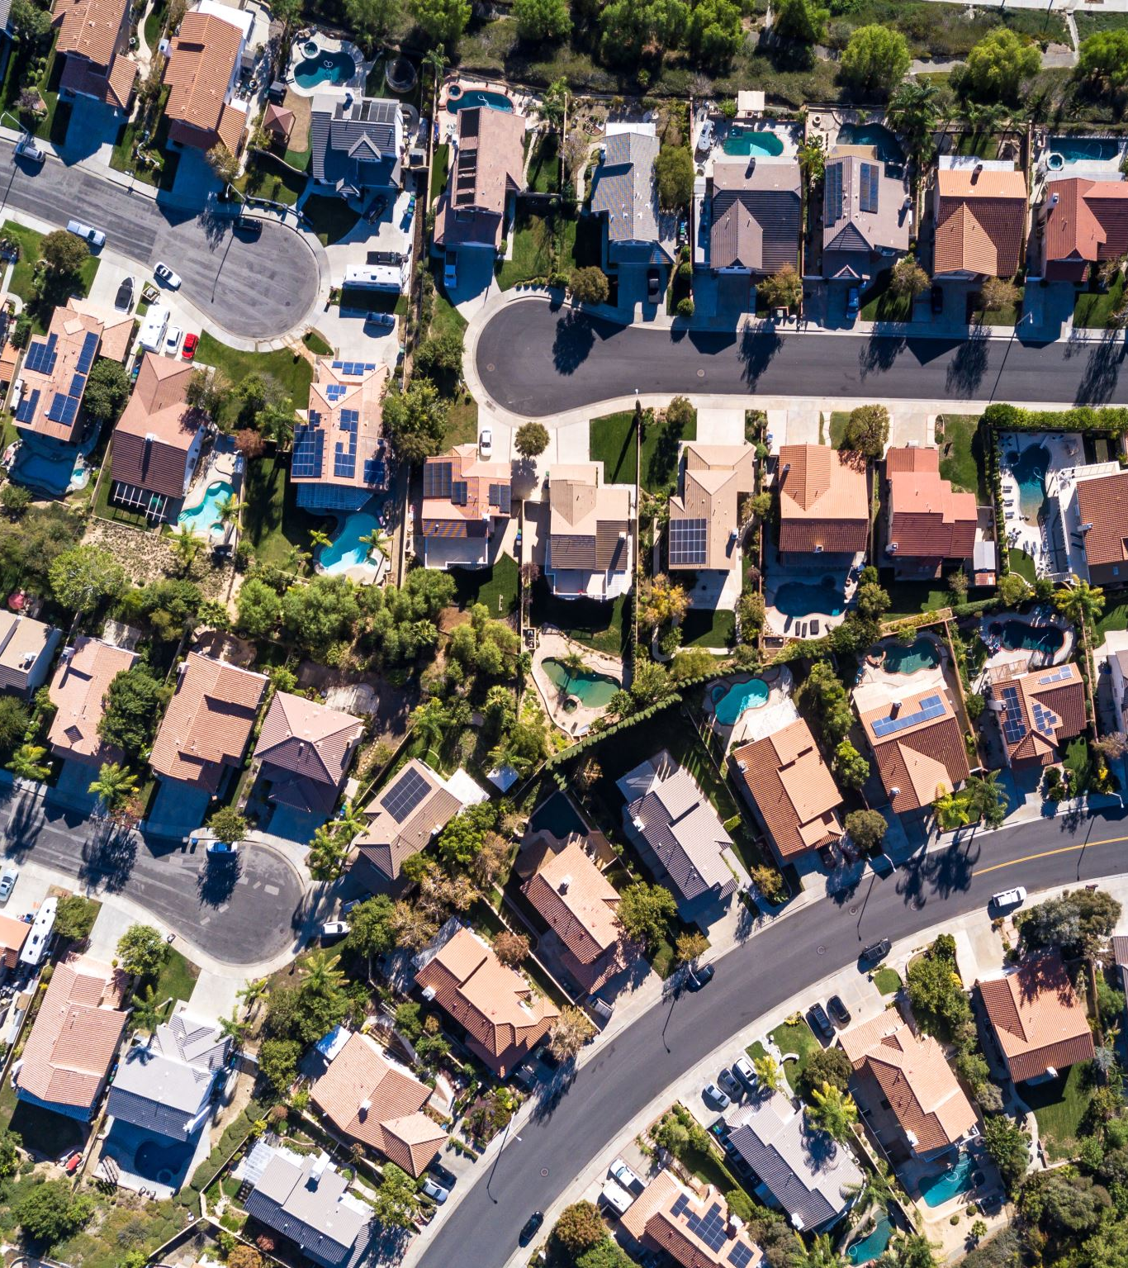
City
Based on this article, affordability of houses varies by states, with the average US house having a price of about 332,911 USD. The most expensive state being Hawaii and the least expensive state being West Virginia. Thus, I decided to keep City column.

Slide 11

House Area (sqm)
"The typical American family can expect to pay about $169 per square foot of house" .This means that as the house area increases the price of the house increases as well. Thus, I decided to keep House Area (sqm) column.

Slide 12

No. of Bedrooms
“An extra bedroom will typically add 15 percent to the resale value of a house”. Naturally if house area has a positive linear relationship with house pricing, having an extra room will in turn increase the house area thus increasing the house price.
Thus, I decided to keep No. of Bedrooms

Slide 13

No. of Toilets
"Adding a new toilet or updating an existing one can increase the value of your home by .5-1% of your home’s value. In general, it is around 66% of the cost of the toilet itself.“ Thus I decided to keep No. of Toilets column.

Slide 14
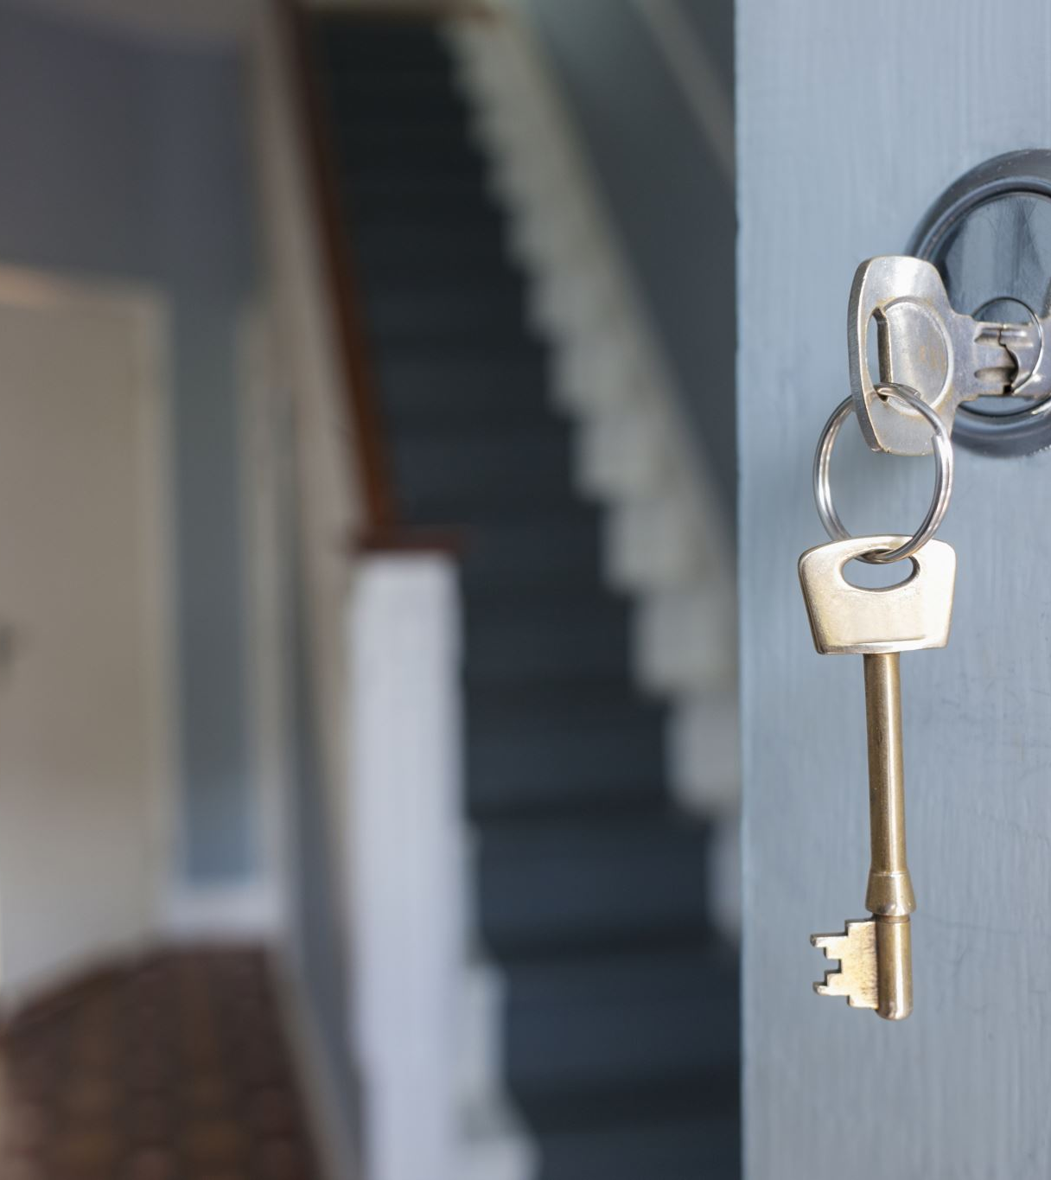
Stories
On average, you can expect to pay 30% more when building a two-story home than a one-story home of comparative size. This also relates to the increase in House Area. Thus, I decided to keep Stories

Slide 15

Renovation Status
Your house value is calculated like this Estimated Current Home Value + (70% x Cost of Renovations) = ARV where ARV means After Renovation Value thus showing that Renovating your home leads to increase in house price. Hence, I decide to keep Renovation Status.

Slide 16
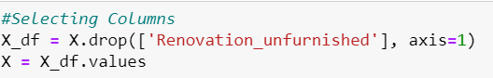
Selecting Columns
I decided to drop Renovation_unfurnished as it has a moderately strong negative linear relationship with Renovation_semi-furnished with a correlation coefficient of -0.6 to prevent multicollinearity.

Slide 17
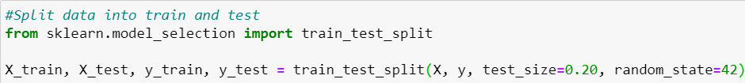
Train test Split
I split the dataset into two parts, 80% to train to train the model, and 20% to test to test the model.

Slide 18
Models
Elastic Net Regression as it reduces overfitting that Linear Regression is prone to using Ridge and Lasso, getting the best of both worlds.
Random Forest as it is robust to overfitting and both Random Forest and Gradient Boosting looks at feature importance which is good in a real-world context such as predicting house prices.
Gradient Boosting since I removed the outliers thus removing the disadvantage of Gradient Boosting being sensitive to outliers. It is usually very precise.

Slide 19
Model Building(Pipeline)
I used Pipeline so that I can chain together a sequence of steps such as scaling my data in putting it into my model.

Slide 20
Model Improvement(KFold)
I then used KFold for cross-validation
The dataset is divided into n subsets or folds of approximately equal size
The model is trained n times, each time using n-1 folds as the training set and the remaining fold as the validation set.

Slide 21
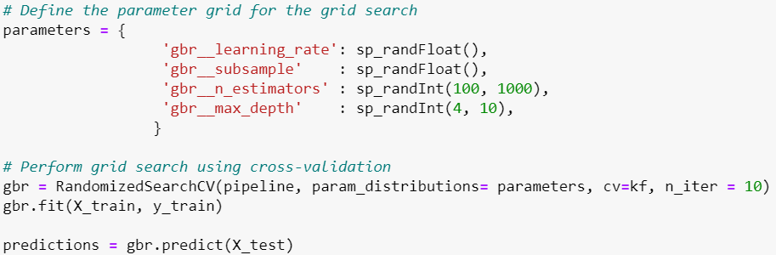
Model Improvement(RandomizedSearchCV)
I used RandomizedSearchCV as I have a lot of hyperparameters to tune.
It will choose a random set of hyperparameters to use and find out which set is the best.
Saves a lot of time

Slide 22
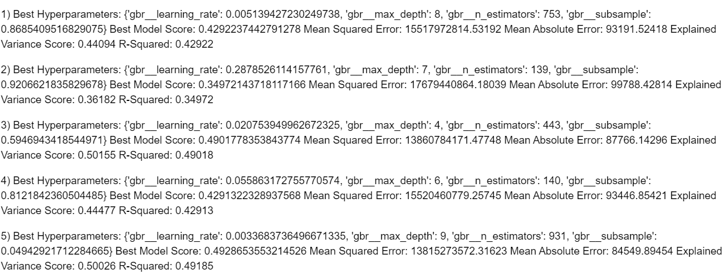
RandomizedSearchCV
Since I used Randomize Search, I rerun the code 5 times to make sure I get a good set of settings for my Gradient Boosting Model.

Slide 23
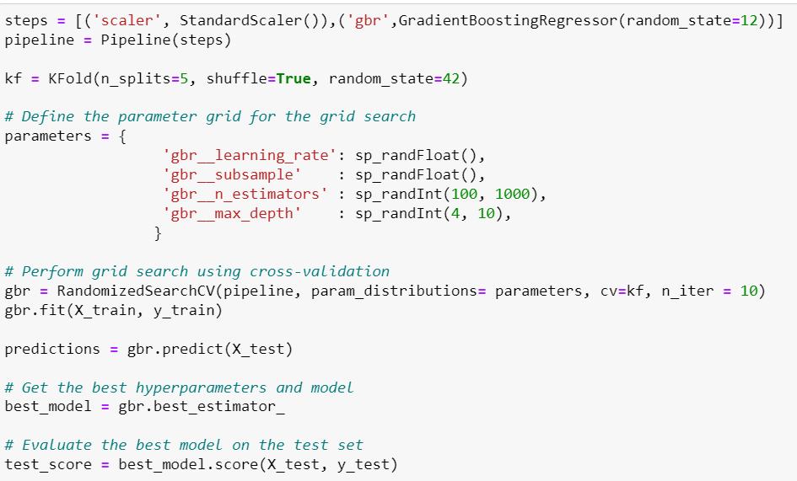
Final Model (Gradient Boosting)

Slide 24
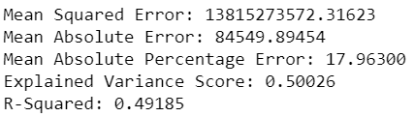
Model Evaluation (Gradient Boosting)
Gradient Boosting was my best model.
It got a R-squared of 0.492, a Mean Squared Error of 13,815,273,572.32, a Mean Absolute Error of 84549.89, a Mean Absolute Percentage of 17.96% and an Explained Variance Score of 0.5
This is not a great score but could be partly due to the output target being in the millions range. Thus, a slight deviation could cause the MSE to skyrocket.
Thus, my MAPE is still alright at 17.96%

Slide 25
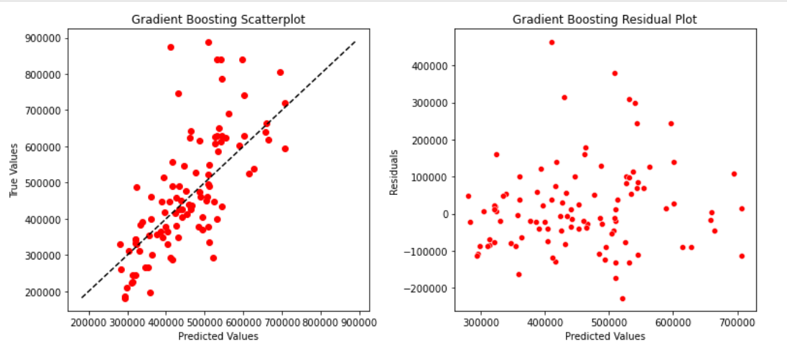
Model Plots
By plotting the model in a scatter and residual plot, I can see the distribution of predicted values and how close it is to the actual values.
Since the points are not very close 0 in the residual plot and most does not touch the line in the scatterplot, I can tell my model’s R-Squared is not very good

Slide 26
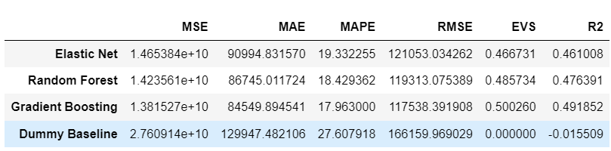
Dummy Baseline
This is all my models compared to the dummy baseline
All my models can be seen outperforming the dummy baseline by quite a lot.

Slide 27
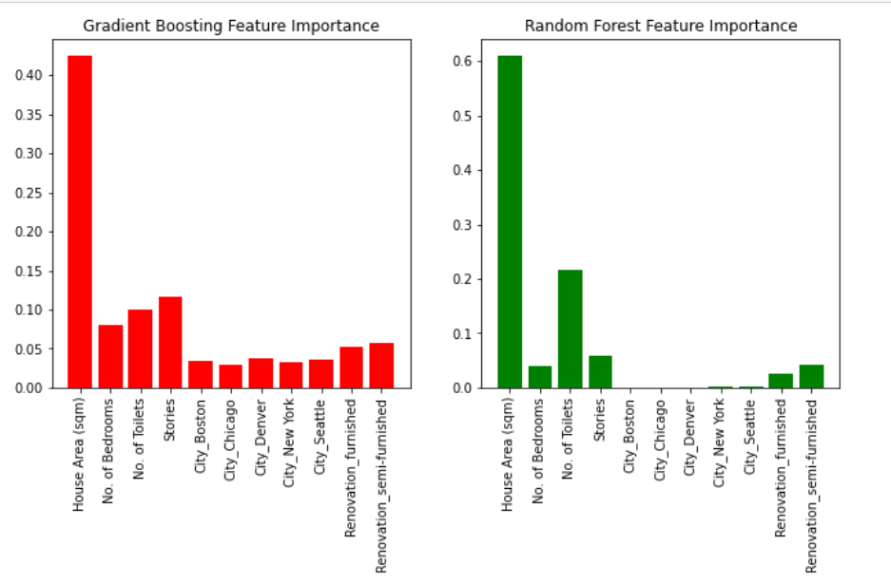
Model feature importance
As expected, the most important feature is House Area (sqm).
It is quite interesting to see the difference in feature importance across models.

Slide 28
Conclusion
House Area is the factor that affects housing price the most.
Although it seems like my model performed very bad, it actual outperforms the dummy baseline.
It also only have a Mean Absolute Percentage Error of 17.96% which means on average it deviates 17.96% of the time which does not seem that bad.
The MSE and MAE could also have been affected by the housing price being in the millions range.

